Slide 1
What is Computer Science?
And will it get me a job?

Slide 2
nmap – Network Mapper – http://nmap.org
ssh – Secure Shell – http://openssh.org
sshnuke – fictional
  But exploit was real – CRC-32 bug in version 1 of ssh

Slide 3
Computer science
is the study of the
theoretical foundations
of information and
computation, and their
implementation in
computer systems.
  Many sub-fields exist; these include:
    Programming languages and compilers
    Parallel and distributed systems
    Software engineering
    Databases
    Artificial intelligence
    Computer graphics
    Etc…

Slide 4
Great, so Computer Science is the study of the theoretical foundations of… what you said.
But will it get me a job?

Slide 5
Security Administrator
  Increasing use of networked computing and Internet
  This means more system and security issues
  Typical Salary Range: $70,000 - $115,000

Slide 6
Software Developer
  Businesses are highly dependent on software
  Worker needs specific skills and industry knowledge
  Typical Salary Range: $56,000 - $92,000

Slide 7
Telecommunications Specialist
  Telecommunications and computer systems are increasingly integrated.
  Knowledge of both areas and the ability to integrate communications and computer systems is required.
  Typical Salary Range: $57,000 - $78,000

Slide 8
Database Administrator
  Responsible for the management and administrator of one or more databases.
  Modern businesses depend absolutely on functional, reliable database systems.
  Typical Salary Range: $66,000 - $92,000

Slide 9
Video Game Developer
  Software developer who creates video games
  May specialize in particular game platforms or genres
  Work hours usually flexible but long working hours are common
  Typical Salary Range: $56,000 - $92,000

Slide 10
“Chicago-based job expert John Challenger recently surveyed 150 human-resource executives to find the fields they see as most promising for college students to train for. The top fields on their list were computer sciences or information technology...” (Christian Science Monitor, 09/04/2009)
“As baby boomers retire, there will be a shortage of skilled workers in IT. This is aggravated by falling enrolment in computer science and engineering at the university level.” (Montreal Gazette, 06/19/2009)
“As the worldwide economic crisis grinds on, companies continue to hire information technology professionals.” (Forbes, 08/06/2009)

Slide 11
CST8201
Operating System Fundamentals

Slide 12
Introduction to basics of Windows and Linux
  Computer hardware
  How operating systems function
  Graphical User Interface
  Command Line Interface
  Directory structures, files, and file attributes
  File systems
  vi
  Scripting in Linux
  System Administration
  “Green” Linux

Slide 13
Operating System Fundamentals
Hardware components of a PC system
Kernel
Functions of an Operating System
Common OSes
Key system utilities

Slide 14
Graphical User Interface
Using the Windows XP Start Menu and Taskbar
Tailoring the Windows XP Desktop
Using Windows Explorer

Slide 15
Command Line Interface
Using the Windows XP & Linux CLI
Displaying the contents of files
Console redirection, pipes
Environment variables
man, less, cut, head, tail, grep, and so on.

Slide 16
Directory Structures
Displaying directory structures
  ls, sort
Navigating directory structures
  cd
Working with directories
  mkdir, rmdir
Working with files
  cp, mv, rm, ln

Slide 17
Files and File Attributes
Files in Windows XP and Linux
More useful Linux commands:
  file
  more
  lsattr
  find
  locate
  updatedb

Slide 18
File Systems
Creating disk partitions
Creating file systems
Windows XP file systems: FAT16, FAT32 & NTFS
Linux file systems: ext2 & ext3
More CLI commands!

Slide 19
vi
Linux text editor
  Overview
  Working with files
  Working with lines of text
  Searching for and replacing text strings
  Regular expressions
  And much more…

Slide 20
Writing scripts in Linux
Writing bash scripts
Script parameters
Conditional execution
  if
  while
  for in

Slide 21
System Administration
Managing processes
Monitoring system performance
Changing file permissions
date, uptime, ps, kill, fg, bg, jobs, watch, free, vmstat, passwd, chmod, umask, chown, ifconfig, wget, rpm, yum, etc., etc., etc…

Slide 22
“Green” Linux
How can Linux be used to conserve resources?
  Using Linux to extend the effective lifespan of older computer hardware
  Configuring Linux to minimize power consumption

Slide 23
Learning Modes
Lecture – lecture hall
  2 hours / week
Lab – computer lab
  2 hours / week
Online – Blackboard
  1 hour / week
Reading – textbook
  4 hours / week

Slide 24
Rules for Lectures
X
No laptops
  Use pen and paper to take notes
No cellphones, iPods, PDAs, etc…
  Do not let your phone ring or answery your phone during lecture
  Do not text, play games, or otherwise use your phone during lecture
No talking, whispering, etc…
Raised hand commands the attention of the lecturer

Slide 25
Rules for Labs
Laptops are permitted for lab work
  Do not watch movies, tv shows or video clips
  Do not play computer games
  Do not chat online

Slide 26
Rules for Labs
Listening to music is acceptable as long as I and other people cannot hear it.
Do not let your phone ring during lab.
  Leave the lab if you have to take a phone call
Do not bring food or drink (including water) into the lab.

Slide 27
Labs
Each student receives a “free” hard drive and caddy (enclosure) on which to store their work
  If you don’t have this yet, go and pick it up at the New Technology store
You should review lab assignments before class
Our lab class is T111
You can also use T114, T115 and T126
Lab attendance is not optional

Slide 28
Collaboration vs. Plagiarism
Collaboration means quietly discussing lab assignments.
  ie. “This is how this works…” (OK)
Plagiarism means doing another student’s work, or copying another student’s work.
  ie. “Click here. Now type this…” (NOT OK)
  Plagiarism can result in expulsion from the course, program or college

Slide 29
Freedom vs. Responsibility

Slide 30
Self-Study
Textbook Reading
  Assigned weekly
  One to three chapters a week
Online Quizzes
  Multiple-choice quizzes
  Posted weekly on Blackboard

Slide 31
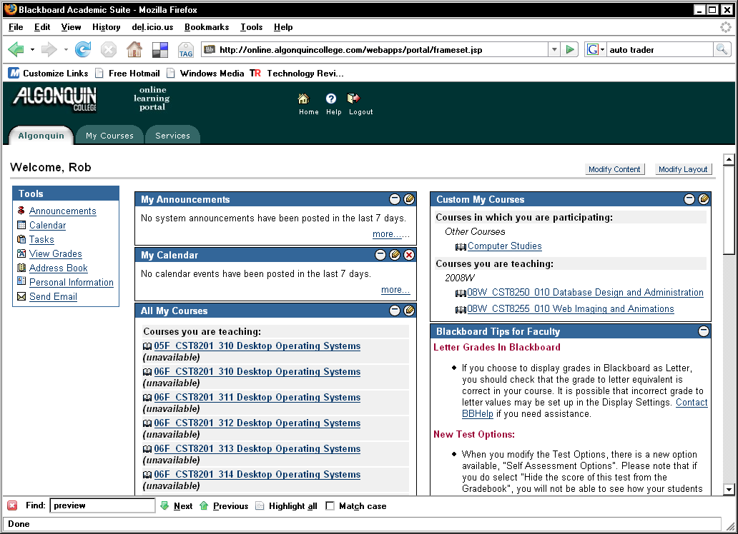
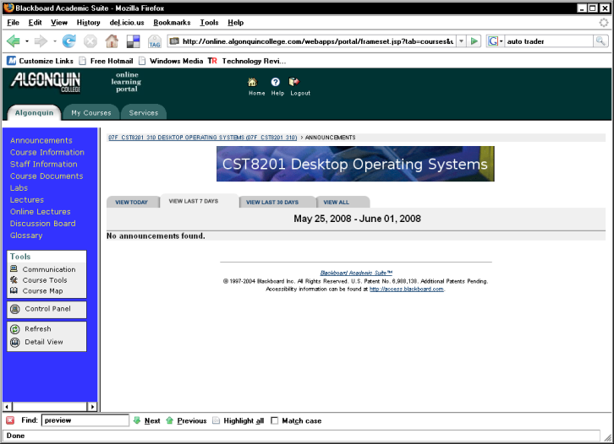
Blackboard
online.blackboard.com
Regular announcements
Course documents
Online quizzes
Discussion forum
Glossary
Need help?
  elearning.blackboard.com
  Learning Resource Center
    Room C102

Slide 32
Online Assignments
Demo quiz here
Note that you have to click “Submit” in order for this to work!

Slide 33
Textbooks
Practical Guide to Ubuntu Linux, 2nd edition
  Mark G. Sobell
  ISBN: 0137003889
  REQUIRED
Linux Phrasebook
  Scott Granneman
  ISBN: 0672328380
  optional but free when you buy the Ubuntu textbook from the bookstore

Slide 34
Textbooks
Installing, Configuring, and Administering Microsoft® Windows® XP Professional - 2nd edition
  T. Northrup et. al.
  ISBN: 0735621527
  Optional
Linux in a Nutshell, 6th edition
  Ellen Siever et al.
  ISBN: 0596154488
  Not published yet... out this month
  Optional but very, very good

Slide 35
Anticipated grades (2008)

Slide 36
Actual grades (2008)

Slide 37
Evaluation
25% Lab assignments
15% Online assignments
15% First midterm
15% Second midterm
30% Final exam

Slide 38
Lab Attendance
Lab attendance is required.
Absence from 3 or more labs results in a course grade of F.
Exceptions to this rule are made only for:
  Sickness (bring a doctor’s note)
  Religious holidays (bring a note from your priest, mullah, rabbi, etc...)
  Death (yours or a family member’s)

Slide 39
Assignment Completion
All assignments (labs and online) must be completed.
Failure to complete all assigned work results in a course grade of F.

Slide 40
Late Labs and Assignments
Any labs or online assignments submitted late receive a mark of zero.
Three or more zeros on labs or assignments will result in a grade of F.

Slide 41
Midterms and Exams
All students are required to write the midterms and the final exam
If you are unable to be at a test for any reason, notify me in advance.
Failure to write a midterm or exam will result in a grade of F.

Slide 42
The “50% minimum”
You must have an average grade of at least 50% on the midterms and final exam combined.
You must have an average grade of at least 50% on your labs and assignment marks combined.
Failure to meet either of these thresholds results in a grade of F.

Slide 43
How to succeed in school
Stay healthy
  Exercise
  Sleep
  De-stress
Come to lectures
Do the reading
Do online quizzes
Show up for lab

Slide 44
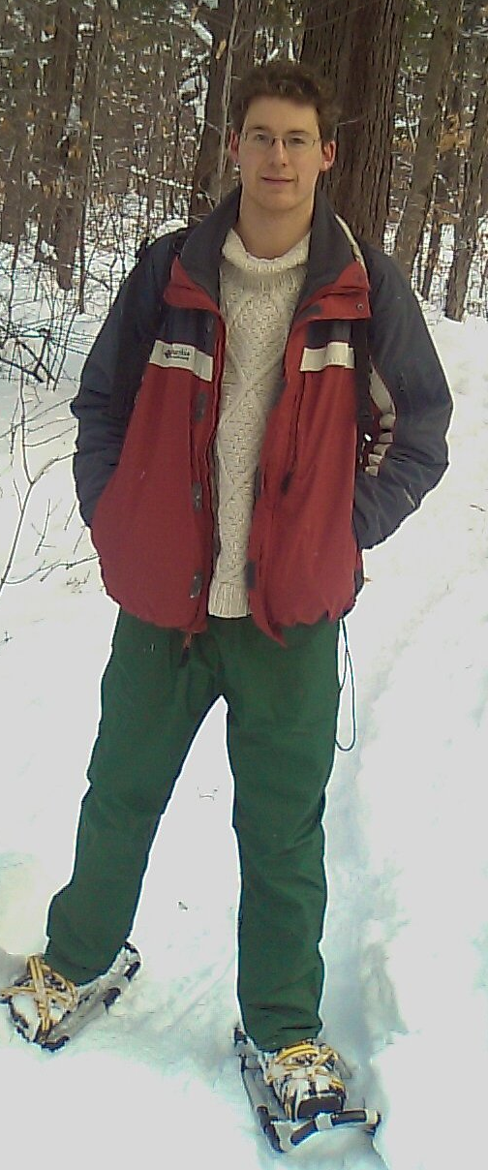
Your Professors
Robert Brandon
  Responsible for:
    Lectures
    Midterms & Exams
    Online material
  How to reach me:
    Email: rob.brandon@algonquincollege.com
    Phone: 613-727-4723 x 7217
    Office: T315
    Blackboard: online.algonquincollege.com
      Post a message in the Discussion Forum for this course
    Open lab: Tuesdays, from 8am to 9am in T111

Slide 45
Your Professors
Norman Han
  Responsible for:
    Labs
    One-on-one help
  How to reach him:
    Email: hann@algonquincollege.com
    Phone: 613-727-4723 x 5950
    Office: T315

Slide 46
Things You Need To Do
Go to the New Technology store and pick up your caddy
  Do this before your lab
  Bring your student card
    If you have no student card, go and get one
Buy your textbook
Check Blackboard

Slide 47
Assigned Reading
Before next week, please read Chapters 1 to 3 from your textbook
  Expect this to take at least 4 to 8 hours of your time – plan ahead!!

Slide 48
Assigned Homework
Check Blackboard
  Quiz #1 – due Monday

